Slide 1
Hyperparameter Auto-tuning

Slide 2
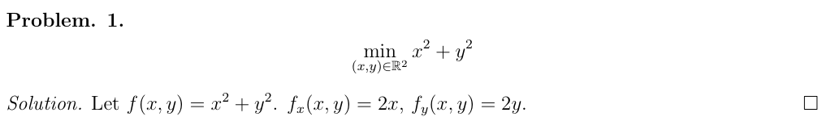
Optimization Problems
Analytic

Slide 3
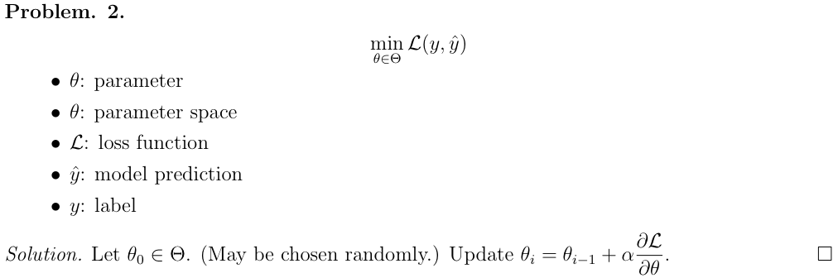
Optimization Problems
Non-analytic

Slide 4
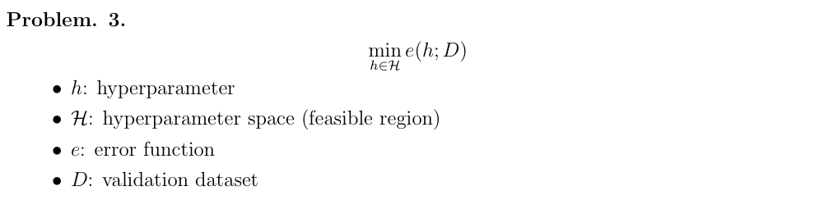
Optimization Problems
Expansive Evaluation

Slide 5
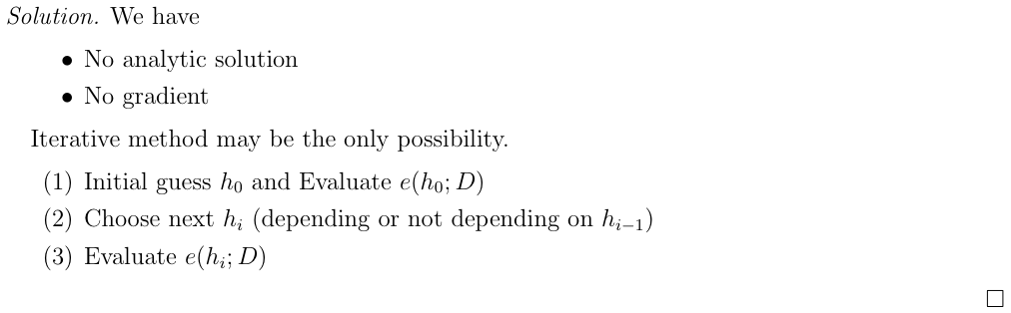
Optimization Problems

Slide 6
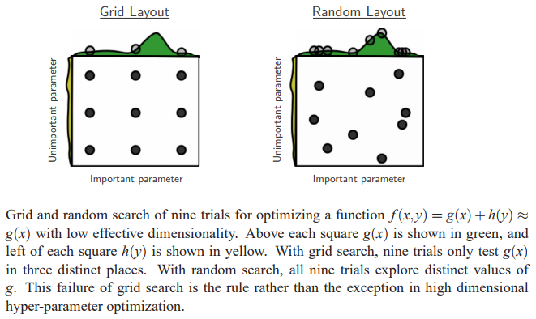
Model-free Method
Random search for hyper-parameter optimization

Slide 7
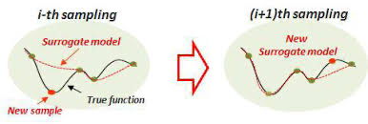
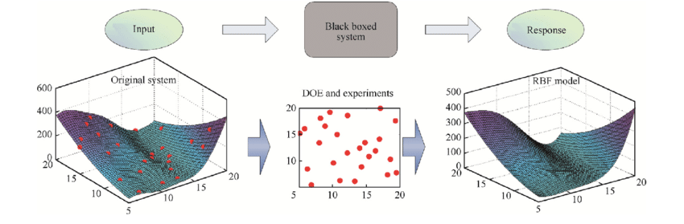
Model-based Method
Bayesian Optimization
[1] A new model updating technique based on kriging surrogate model for bridge structures
[2] A hierarchical updating method for finite element model of airbag buffer system under landing impact

Slide 8
Thank you

